Slide 1




DIGITAL LITERACY
SKILLS
INTERMEDIATE USERS

Slide 2
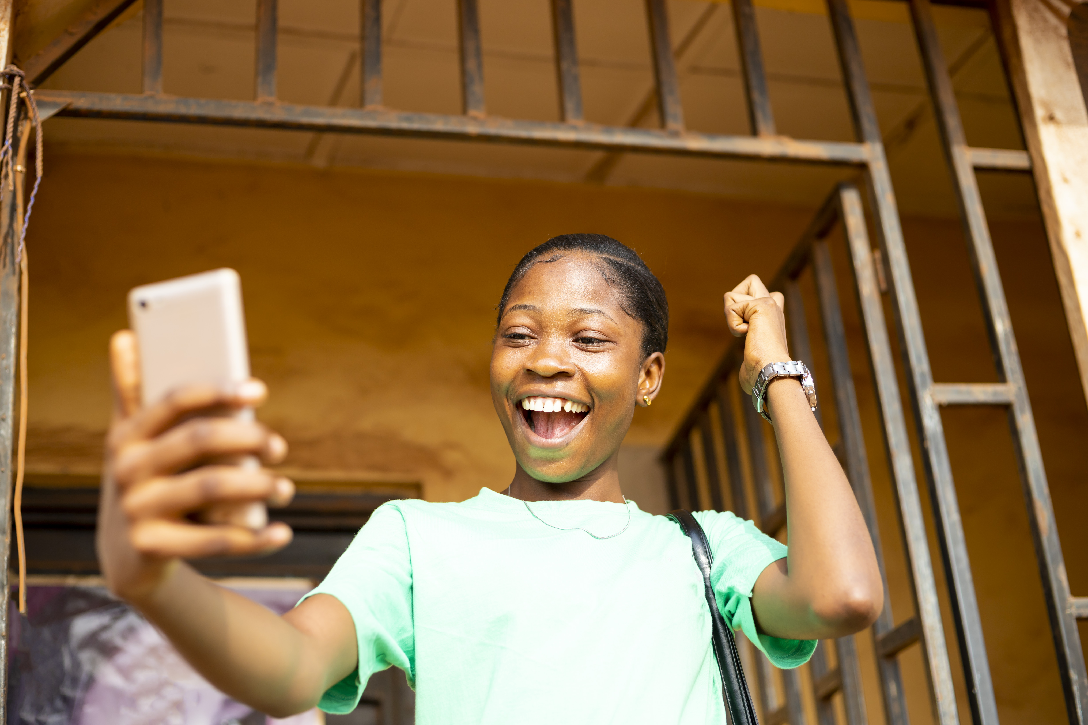
Module 4
Content

Slide 3

1
Unit 1: Developing digital content

Slide 4

Developing digital content
Digital content is any content you create on a computer, tablet, or mobile phone.
The content can be:
text
sound (audio) recorded using a tablet or smartphone
videos created using a tablet or smartphone.
Some digital content is created for personal use only and is not shared online.

Slide 5
Developing digital content
Examples of local digital content that is not shared:
a to-do list created in a plain text editor, such as Windows® Notepad
notes, research and website addresses in a Microsoft® Word or Google® Docs document a learner uses to write an assignment
a personal budget created on an electronic spreadsheet, such as Microsoft® Excel or Google® Sheets
a photo taken on smartphone
a drawing created with graphics software, such as Adobe® Illustrator
a voice note recorded on a smartphone
a video of children playing recorded on a camcorder.

Slide 6

Using installed applications to create digital content
File formats for digital content
There are various types of media.
The format of a digital file depends on the formats supported by the hardware and software used to create the file.
It’s important to select the correct file format when uploading content to the internet.
Images: JPG, PNG, and GIF
Audio: MP3, WMA, and FLAC
Video: AVI, MP4, and MKV

Slide 7

Common types of online digital content
Blogging
Longform content
Infographics
Podcasts
Video and vlogs

Slide 8
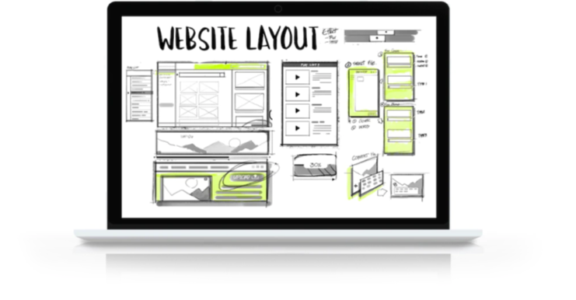
Create a website
Reasons for creating a website
Businesses, groups, schools and other organisations create websites for the following reasons:
professionalism and increased trust
a business website will bring you more customers
contact information and live chats.

Slide 9
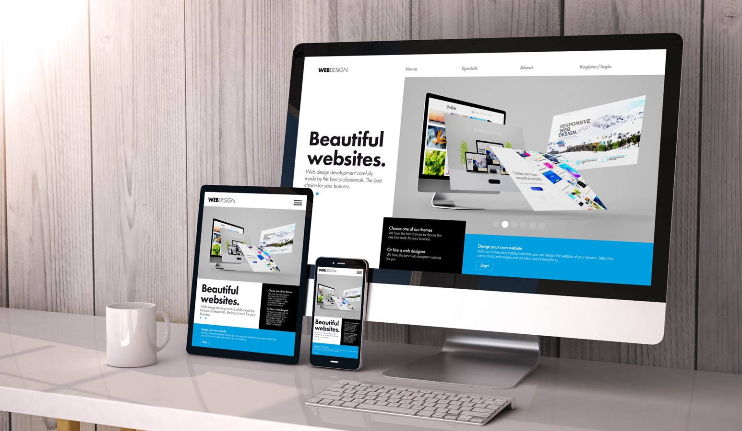
Create a website
Create a website using a template and existing platform
There are many excellent free website platforms with varying features.
There are free website builders you can use to create your own website based on a design template.
You don’t need to know how to code the website and you don’t need to design the layout.

Slide 10
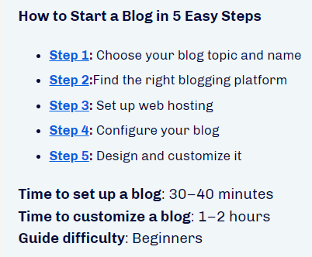
Skills to practise
Produce complex digital content
Create a list of the birthdate of everyone in your class.
Open Excel or any other programme and create a pie chart showing the number of birthdays in each month of the year.
Use this website to help: https://www.wikihow.com/Make-a-Pie-Chart-in-Excel
Use a template
Follow the steps in this website and create a blog: https://websitesetup.org/how-to-start-a-blog-guide/

Slide 11
All back covers should include
contact information of the section
producing the work.
© United Nations Children’s Fund (UNICEF) [month and year of publication]

